Slide 1

“Helping People Build Their Assets”

Slide 2

ABOUT US
Prime Ventures Builder is built upon the core values of transforming lives through effective marketing and financial strategies, as well as charitable initiatives. Our innovative system provides individuals with the tools they need to build successful businesses and assets. In addition to this, we offer Crypto-Fintech services including our Asset Store Application and Asset Payment Application, which have been developed in-house to offer our clients seamless access to cutting-edge financial technology. With a commitment to excellence, Prime Ventures Builder is dedicated to empowering individuals and revolutionizing the world of business.
We understand that the business landscape is constantly evolving, and we are committed to staying ahead of the curve. To this end, we have made significant investments in upgrading our infrastructure and continually innovating to develop cutting-edge programs and technologies that meet the evolving needs of our customers, users, and distributors. Our unwavering dedication to staying at the forefront of the industry ensures that we remain competitive and well-positioned to provide our clients with the highest levels of service and support. With a focus on innovation and customer satisfaction, Prime Ventures Builder is poised to meet the challenges of today's market and shape the future of business.
At the heart of our project is a deep commitment to community involvement and empowerment, both now and for future generations. As the financial landscape continues to evolve and traditional models are increasingly challenged, it is more important than ever to find new ways to come together and solve problems. We believe that radical acceptance and adaptation to financial innovation are essential in this process of financial recovery. Community-run projects that prioritize collaboration and innovation have a critical role to play in building a more equitable and sustainable future. By embracing new ways of thinking and working together, we can create a more resilient and inclusive financial system that serves the needs of all.

Slide 3
OUR VISION
Our ultimate goal is to empower individuals to achieve their dreams and leave a lasting legacy for themselves, their families, and their communities. We believe that by providing people with the tools, resources, and support they need to pursue their passions, we can help them become a positive force for change in the world. By fostering a culture of empowerment and collaboration, we strive to create a ripple effect of impact that extends far beyond our immediate sphere of influence. Our vision is to build a world where everyone has the opportunity to fulfill their potential and leave a meaningful legacy that inspires future generations.
OUR MISSION
We aspire to be a conduit of blessings to deserving individuals by:
A. Providing guidance on how to conduct ethical and sustainable business practices.
B. Promoting the importance of saving a portion of their hard-earned income.
C. Equipping them with the knowledge and tools necessary to invest in their future.
Through these efforts, we hope to empower individuals to achieve financial independence and realize their goals. By promoting responsible business practices, encouraging sound financial habits, and fostering a culture of investment, we aim to create a positive impact in the lives of those we serve. Our commitment to helping others succeed is rooted in a deep sense of purpose and a desire to build a better world for all.
OUR GOAL
Our aim is to build a robust community ecosystem that empowers individuals and fosters collaboration through community-run projects. We believe that by creating a culture of engagement and mutual support, we can build a strong foundation that benefits all members of the community.
Our approach is rooted in the belief that local communities have the knowledge, creativity, and resources needed to drive positive change. By promoting community-run projects, we strive to harness the power of collective action and unlock the full potential of the community. Through these projects, we seek to address pressing social and economic issues, strengthen local networks, and empower individuals to take an active role in shaping their own future.
At the core of our mission is a commitment to promoting equity, inclusivity, and sustainability. By working together to build a thriving community ecosystem, we can create a brighter future for all.

Slide 4

Leadership
The ability to uplift less fortunate people to financial freedom.
Passion
Committed by action, heart, and mind.
Integrity
Be honest, genuine, and reliable.
Service
Aiming excellency

Slide 5



Our Products
Prime Ion Eyeglass
Benefits
Prevents and reduces radiation fatigue
Enhances oxygen supply to the eyes and the brain
Relieves migraine and headache
Reduces sinusitis
Reduces vertigo
Reduces premature aging

Slide 6

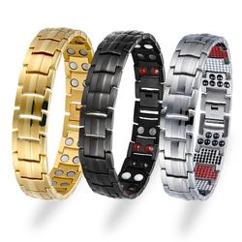
Our Products
Prime Magnetic Bracelet (Negative Ion)
Benefits
Boosts mood
Alleviates depression
Reduces stress
Improves cognitive function
Improves sleep

Slide 7
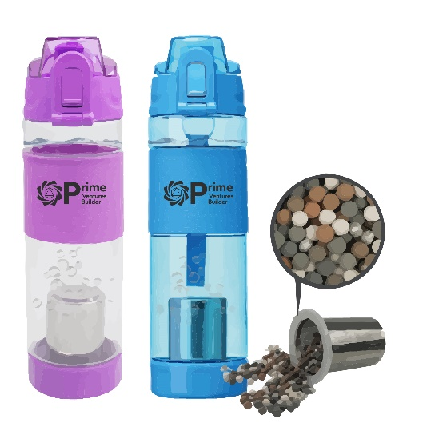

Our Products
Prime Alkaline Water Mug
Benefits
Improves overall bone health
Soothes acid reflux
Reduces high blood pressure blood sugar, and cholesterol
Enhances bodily hydration
Improves longevity

Slide 8


Our Products
Prime Sanitary Pad & Panty Liners
Benefits
Prevents pad rashes
Eliminates unwanted odor
Helps reduce period pains
Fights against infections and vaginal irritation

Slide 9


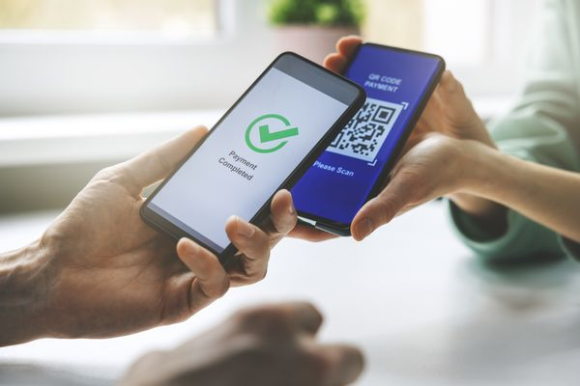


PROJECTS
Fintech Apps
Crypto Currency - Prime Asset Coin
Digital Money / Electronic Money
Primarily Used for Commodity Payment, Real-Estate Payment, Payment for Booking Resorts and Hotels, and others.

Slide 10

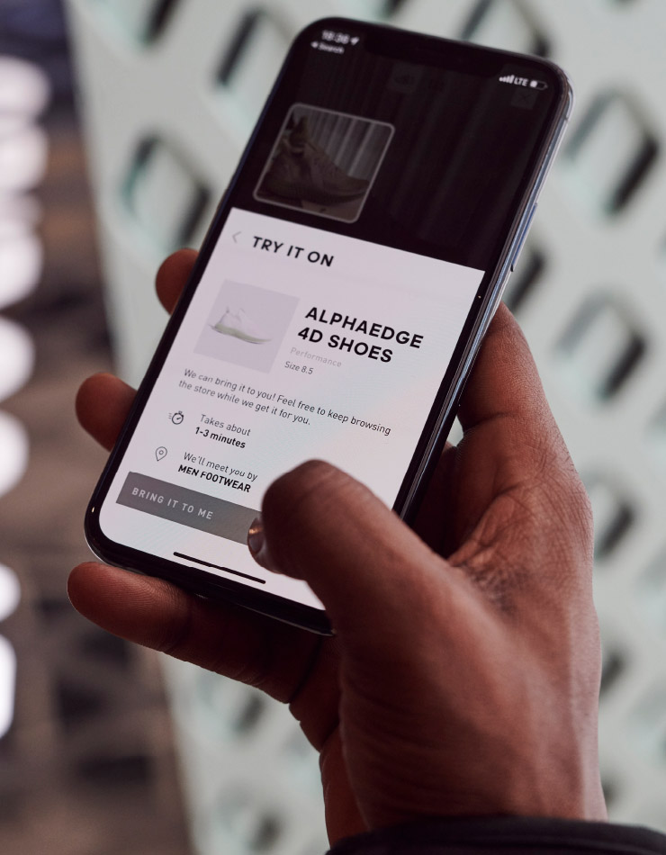

Prime Store App
Prime Payment App

Slide 11
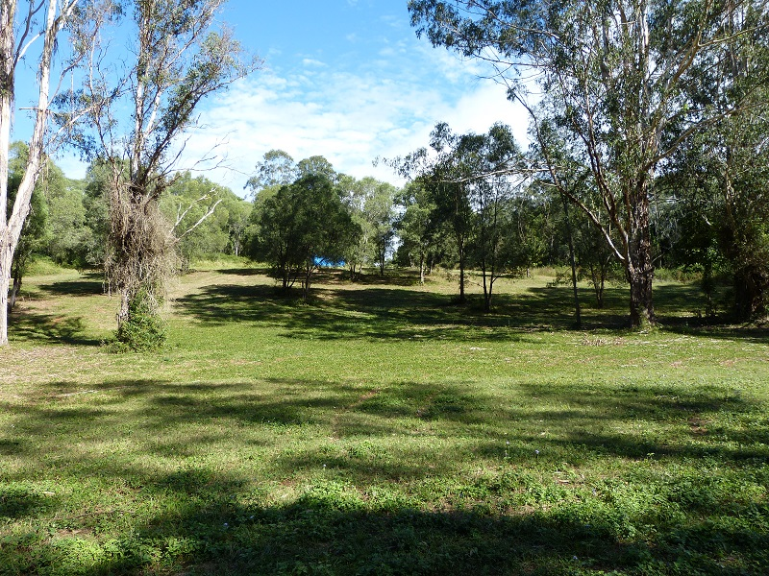


REAL ESTATE
Acquire raw land at lower cost
Develop partnerships with other Real Estate Companies

Slide 12

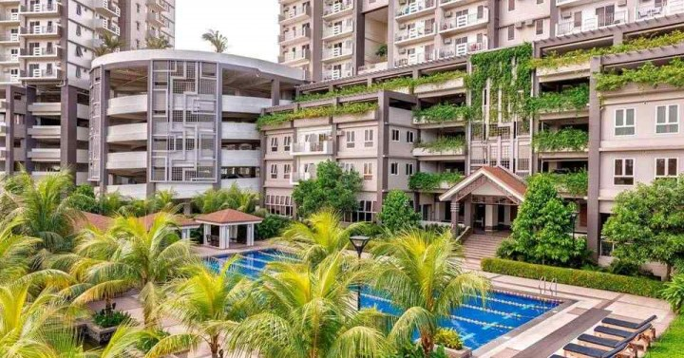

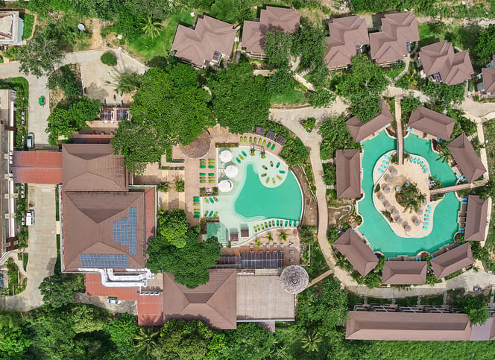
Development
Subdivision
Condo Units
Park
Resort

Slide 13






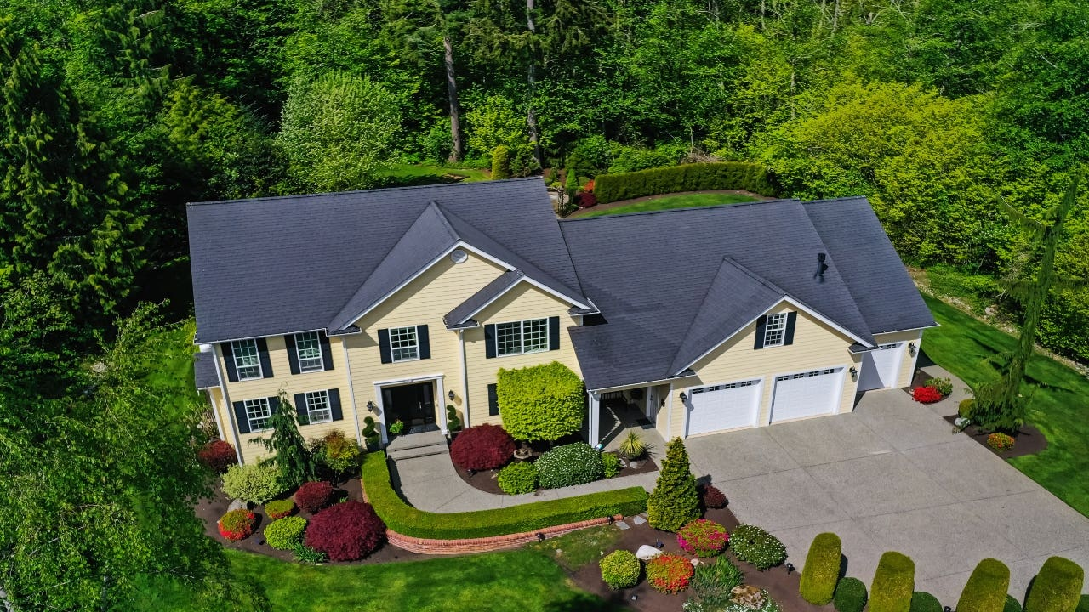
OUR STRATEGY
Reality
Members
Prime Ventures Builder
Power
of
Unity
Dreams

Slide 14
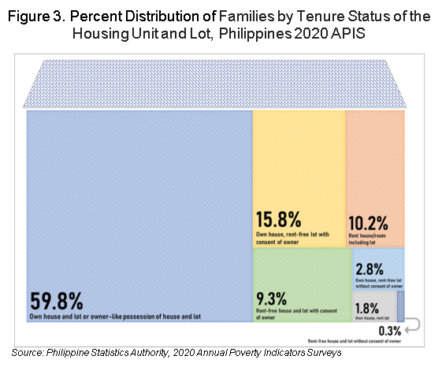
HOUSE AND LOT LAY-AWAY PROGRAM
The Philippines is facing an alarming increase in the number of people who do not own their own homes, resulting in a rise in homelessness as indicated by the latest PSA survey. In response to this urgent social issue, our company has developed a system to assist our members in acquiring their own properties, such as houses and lots, and securing their income through our mass-based marketing platform.
We believe that access to affordable housing is a fundamental human right, and our system is designed to help our members achieve this goal. Through our platform, we offer a range of resources and support to help our members navigate the complex process of acquiring property, including financial planning, legal guidance, and access to affordable financing options.
We are committed to promoting equitable and sustainable development that benefits all members of society. By empowering our members to achieve greater financial security and stability, we believe we can contribute to the creation of a more just and prosperous society for all.
59.8% - Owner House and Lot
40.2% - Have no House and Lot
Note: Other survey says :
4% - Homeless (cant afford)

Slide 15
How To Acquire Property
Traditional Way Reservation Fee : PHP 30,000 Total Area : 150 square meter Price per square meter : Php5,500.00 Total Lot Price : Php825,000.00 Interest : 1% Timeframe : 10 Years to Pay Annual : Php82,500.00 Quarterly : Php20,625.00 Monthly : Php6,875.00 | Prime Ventures Builder No Reservation Fee, Just avail of our packages. We will teach you how to earn Encourage you to save Empower you how to invest in Real Estate Timeframe : 10 years to pay

Slide 16
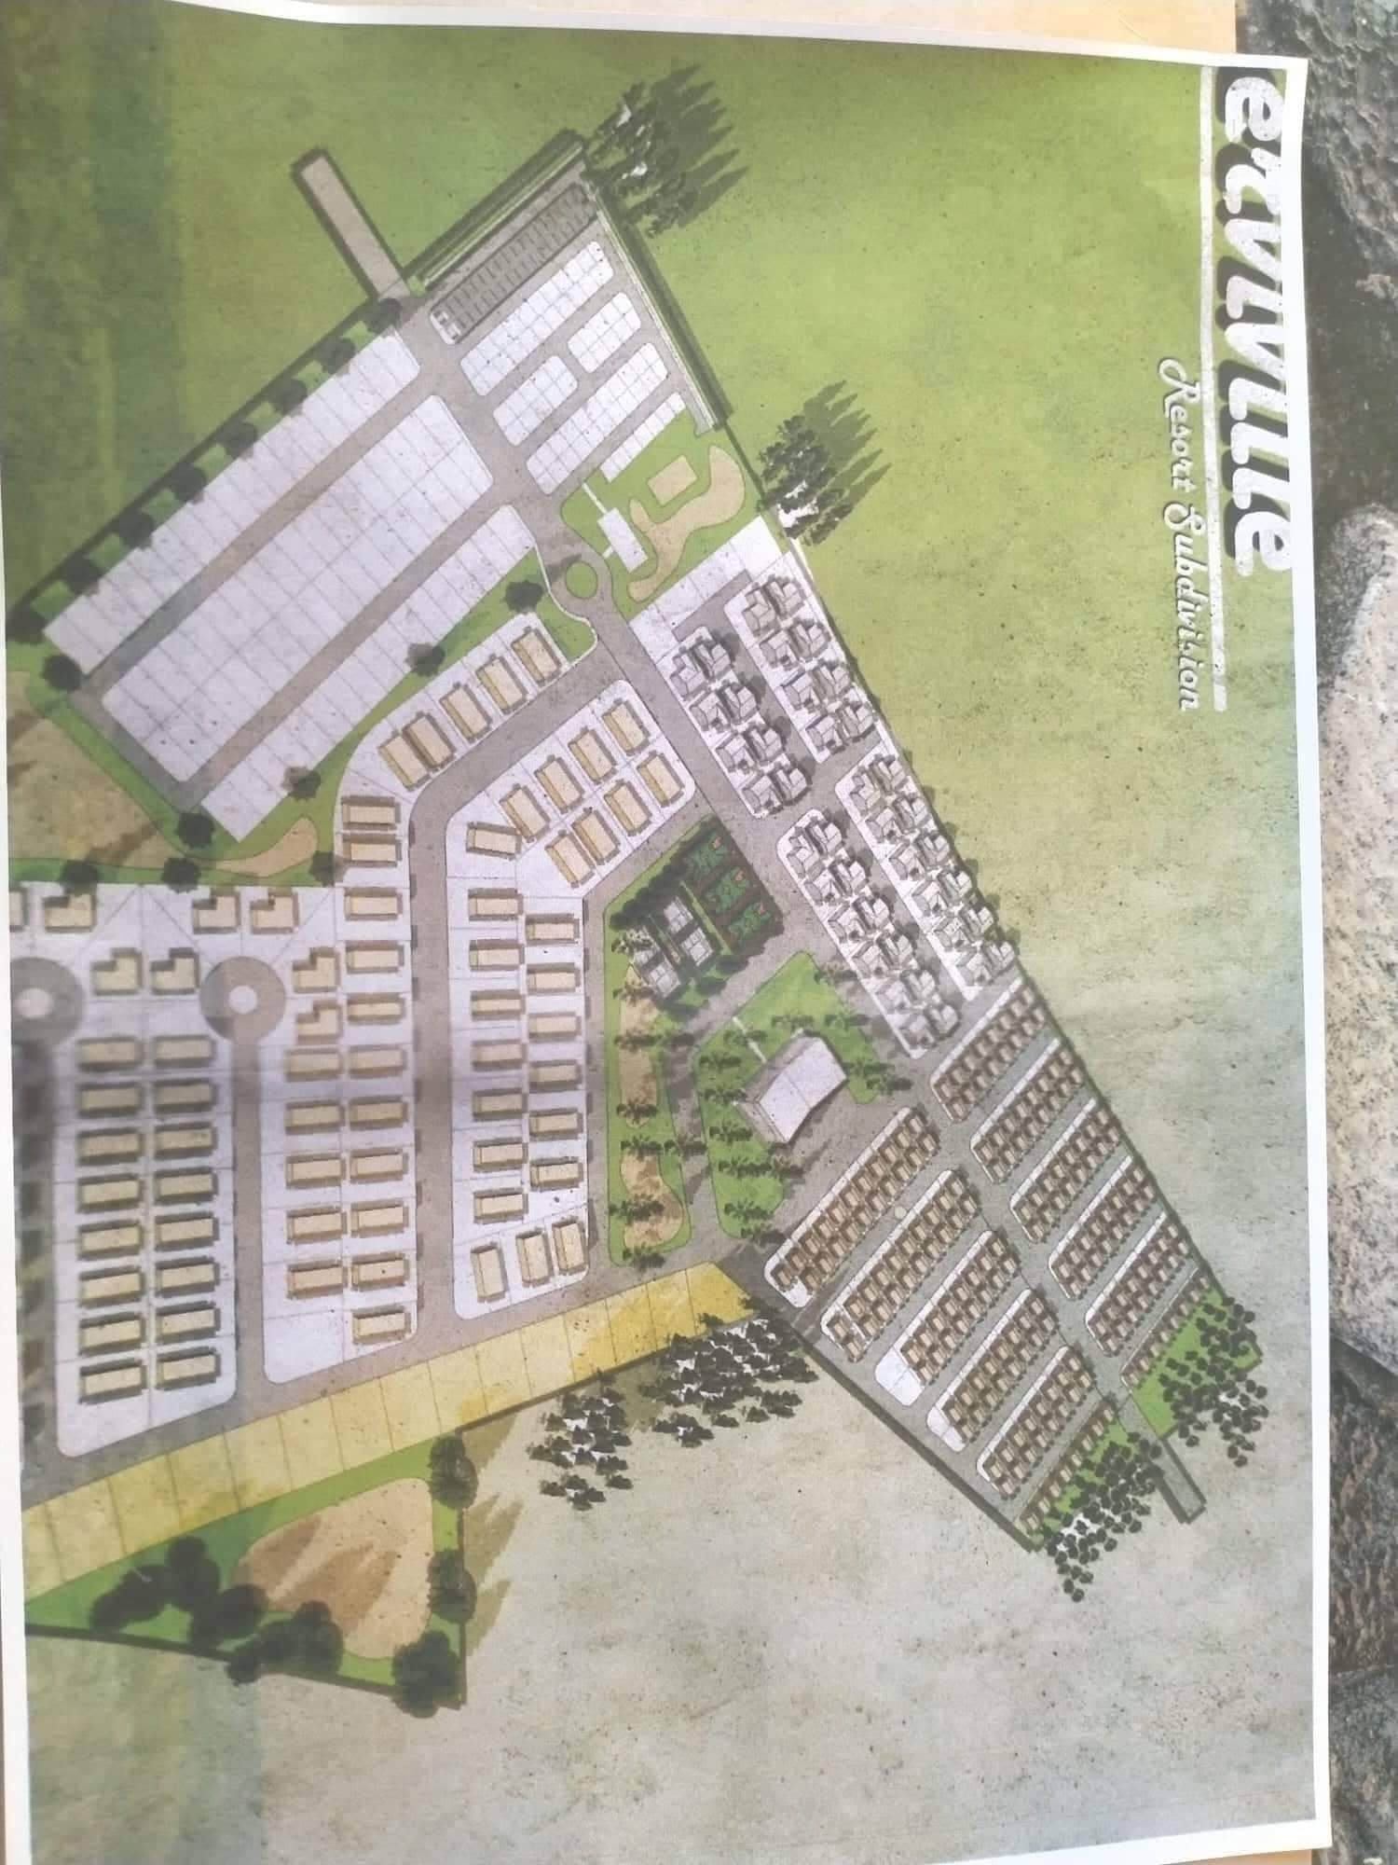
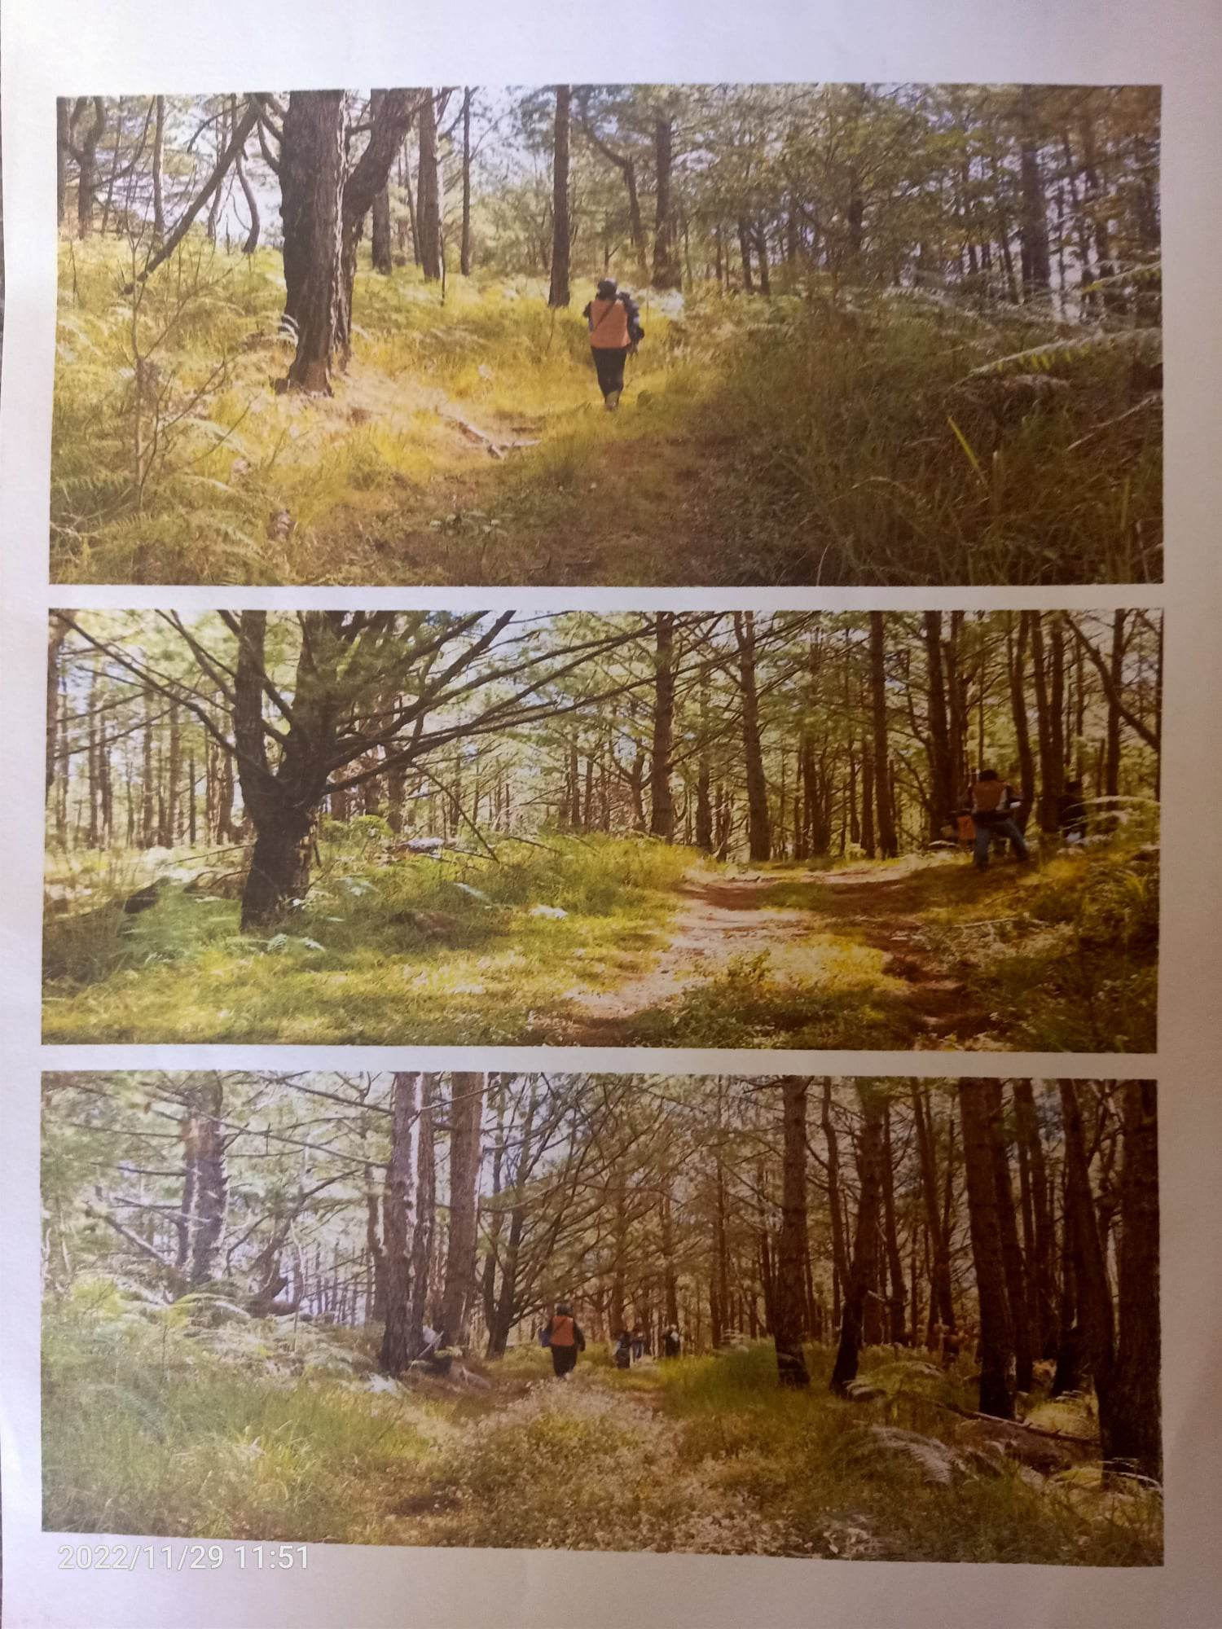
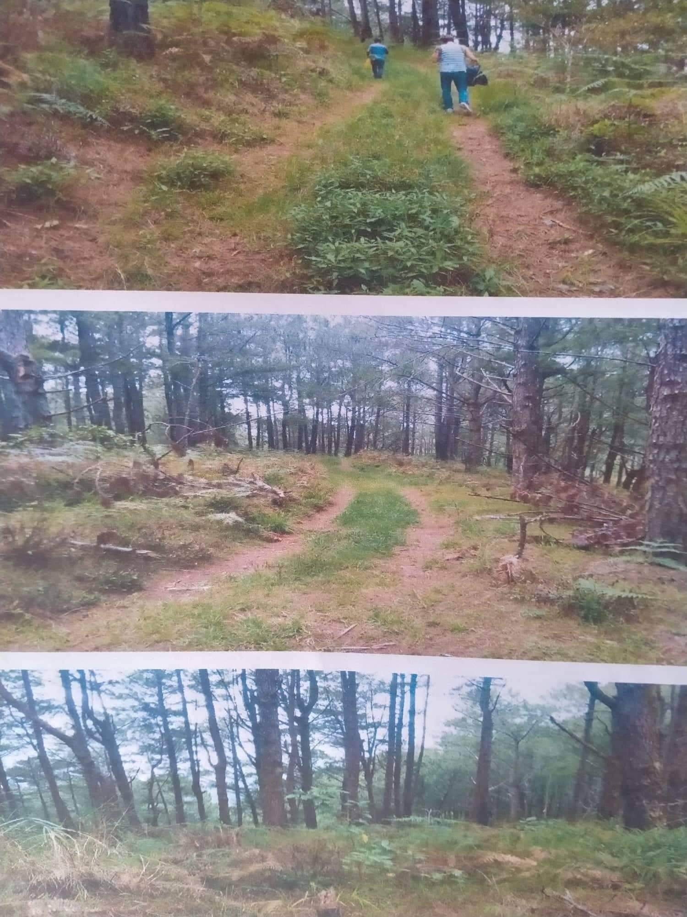
Proposed Project
Location : Kengosan, Twin Peaks, Tuba, Benguet
Total Area : 234,587 square meter
Status : Clean Title
Projection : 10 years program

Slide 17

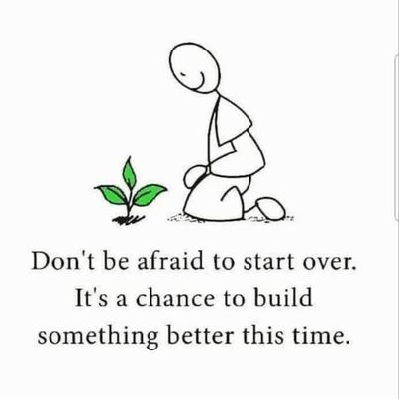
THANK YOU!

